Slide 1
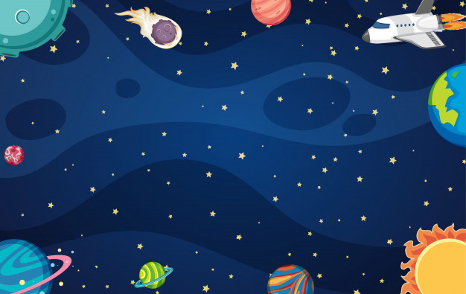
Solar System
Ms. Edwards

Slide 2
Essential Question:
What are some characteristics about the sun that make it so important for our solar system?

Slide 3
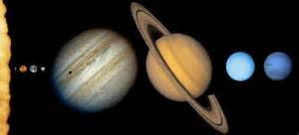
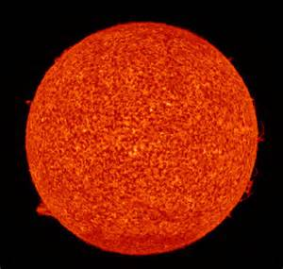
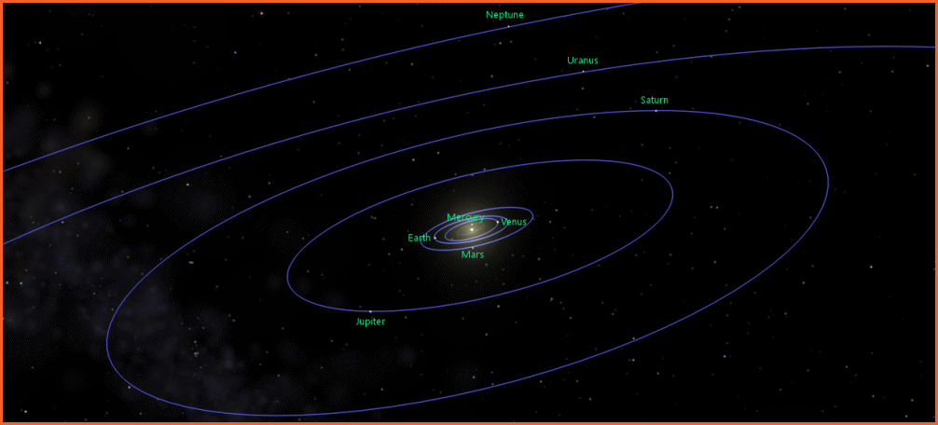
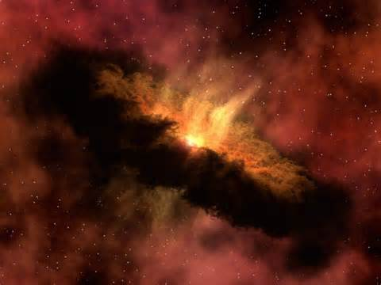
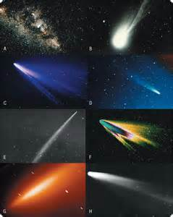
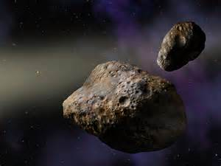
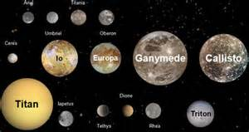
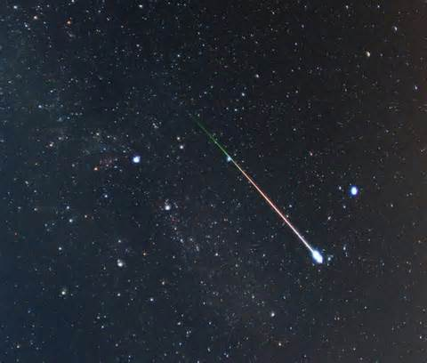
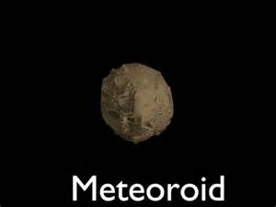
The Solar System consists of
the Sun,
planets,
moons,
asteroids,
meteors,
comets,
dust, gases
and primarily empty space.
Notes:
Print out of North Carolina unpacked standards for teacher plan book

Slide 4
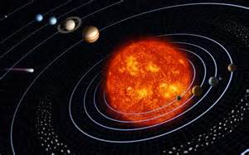
The Solar System consists of
the Sun,
planets,
moons,
asteroids,
meteors,
comets,
dust, gases
and primarily empty space.
Notes:
Print out of North Carolina unpacked standards for teacher plan book

Slide 5
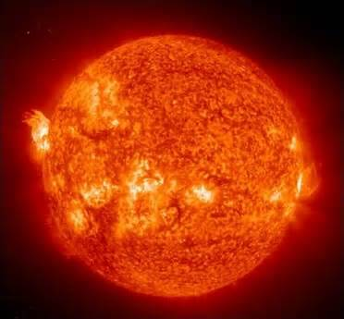
THE SUN
Notes:
Print out of North Carolina unpacked standards for teacher plan book

Slide 6
The sun is enormous compared to the Earth. The sun creates a lot of gravity because it is so big.
The sun’s gravity is a force that holds all eight planets in their orbits as they circle around it.
Energy and light from the sun travel to us.
Notes:
Print out of North Carolina unpacked standards for teacher plan book

Slide 7
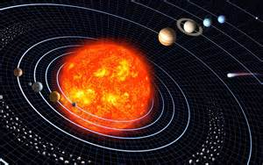
The sun is orbited by eight planets, at least five dwarf planets, tens of thousands of asteroids, and hundreds of thousands to three trillion comets and icy bodies.

Slide 8
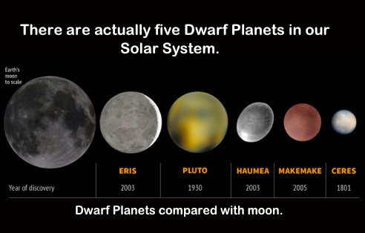

Slide 9
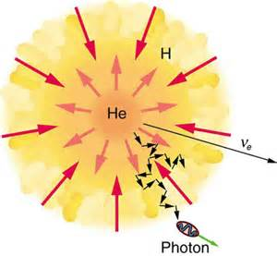
The Sun is made of hydrogen and helium.
Notes:
Print out of North Carolina unpacked standards for teacher plan book

Slide 10
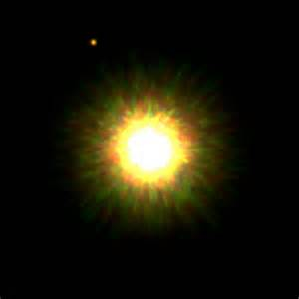
The sun is a star. A star does not have a solid surface, but is a ball of gas held together by its own gravity.

Slide 11
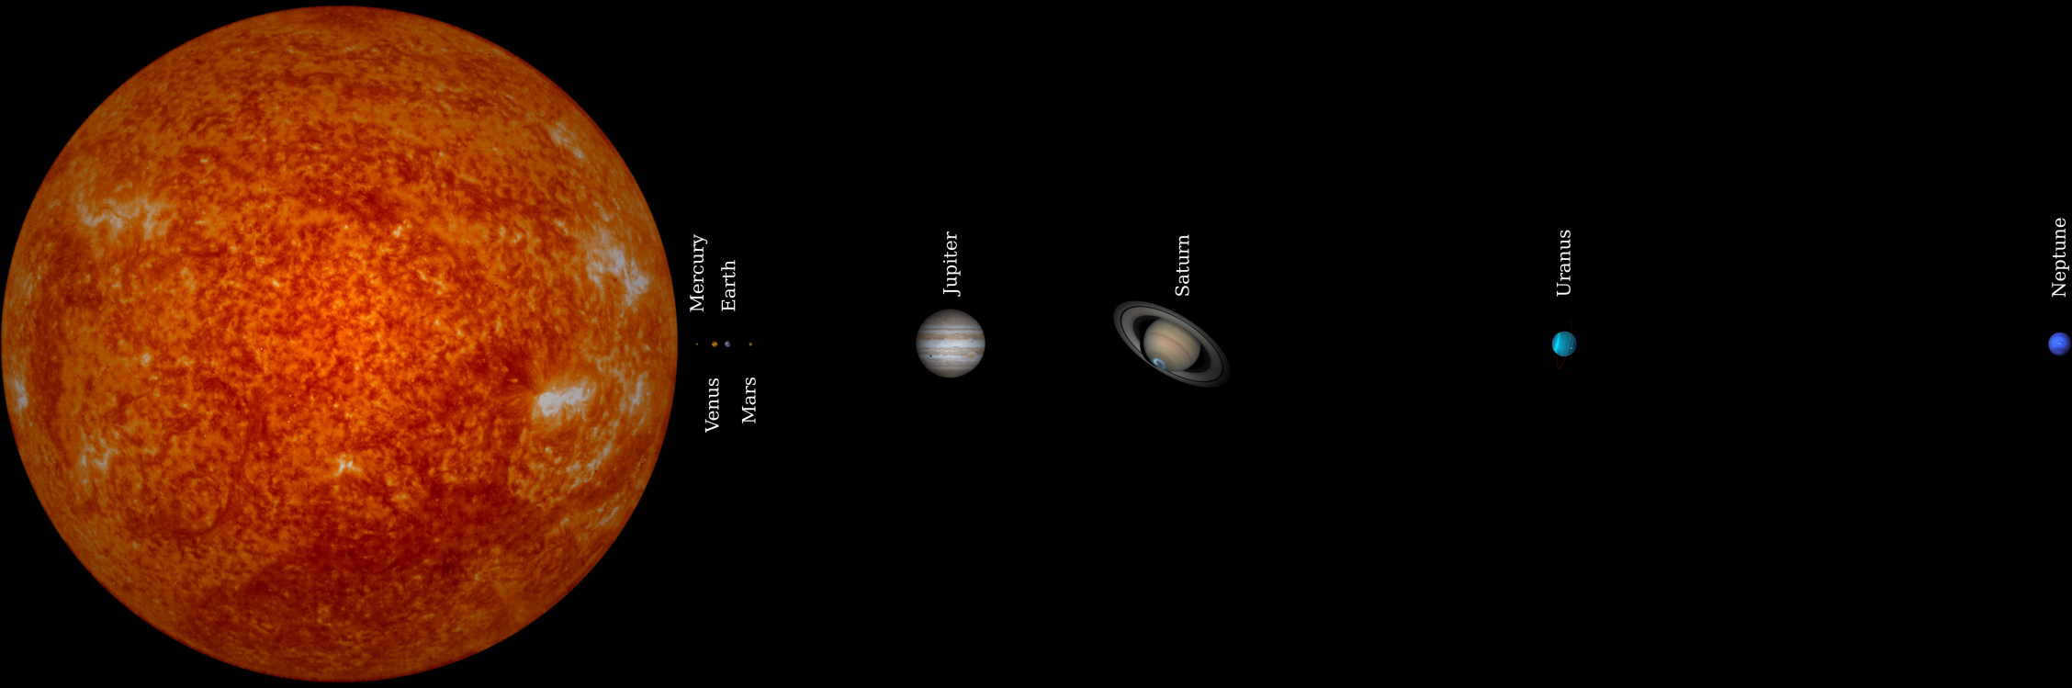
The sun is the center of our solar system and makes up 99.8% of the mass of the entire solar system.

Slide 12

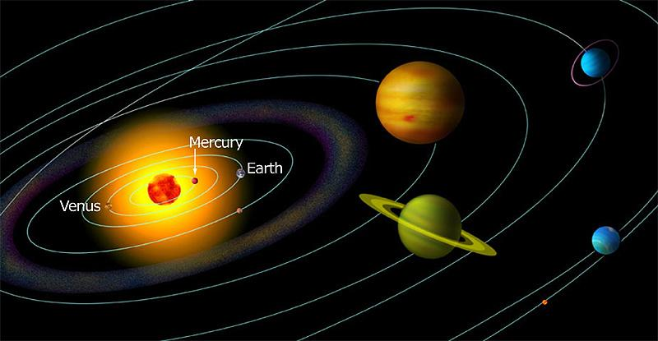
There are 8 planets in our solar system. These 8 planets orbit the sun in an elliptical orbit.

Slide 13
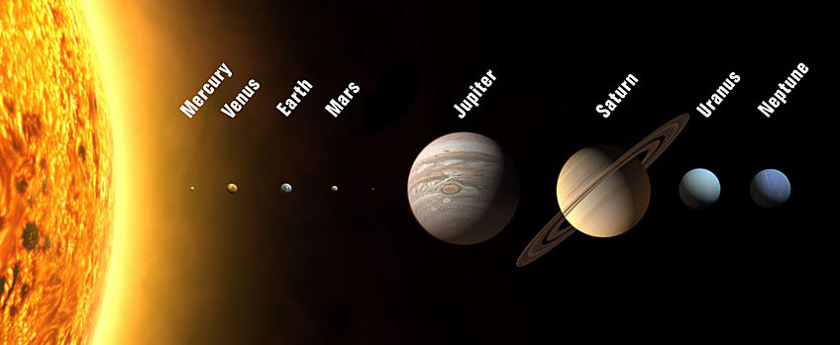
How can you remember the order?
Notes:
Print out of North Carolina unpacked standards for teacher plan book

Slide 14
My
Very
Educated
Mother
Just
Served
Us
Nachos
Mercury
Venus
Earth
Mars
Jupiter
Saturn
Uranus
Neptune
Notes:
Print out of North Carolina unpacked standards for teacher plan book

Slide 15
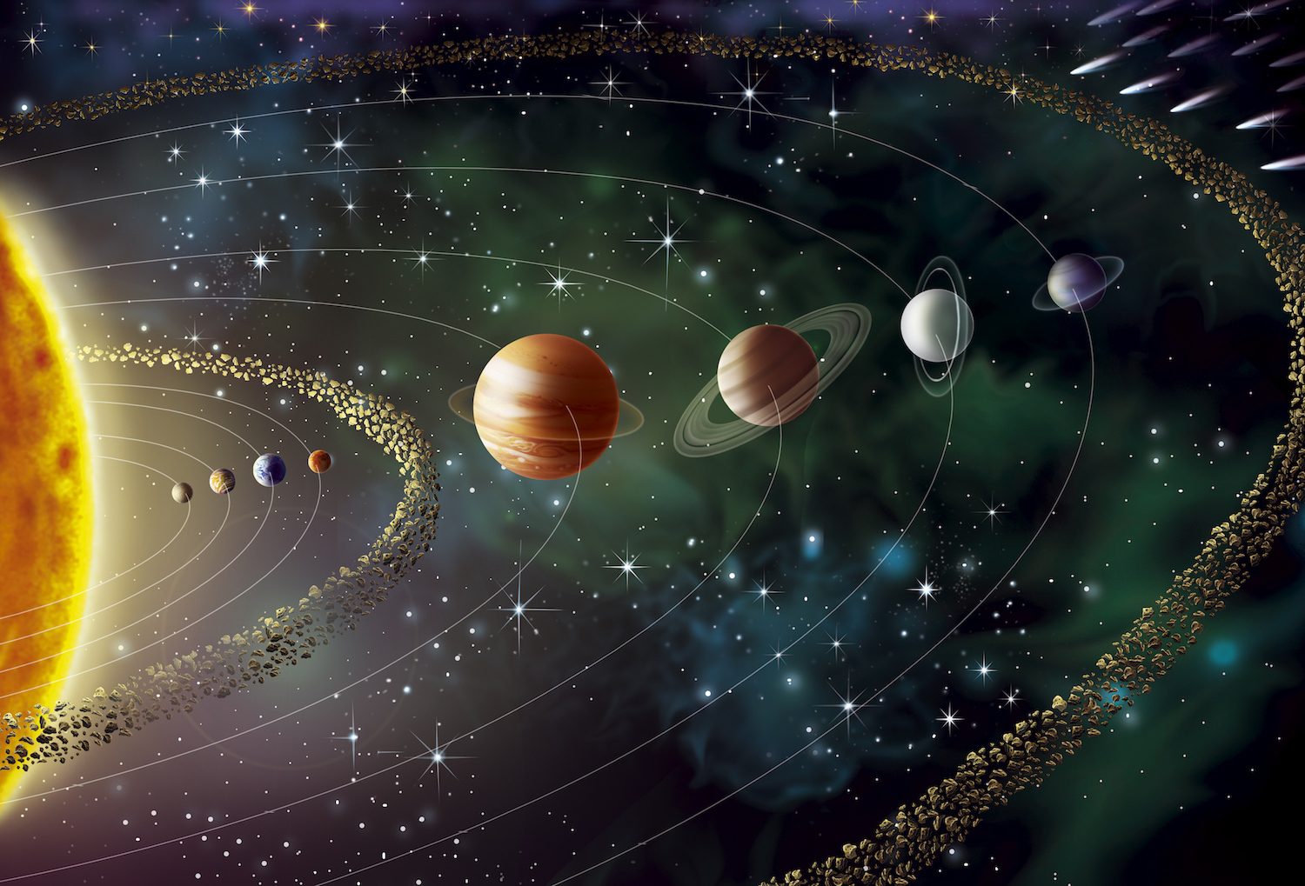
Planets are the largest objects in the solar system and due to the Sun’s gravitational pull, they revolve around the sun.
Notes:
Print out of North Carolina unpacked standards for teacher plan book

Slide 16
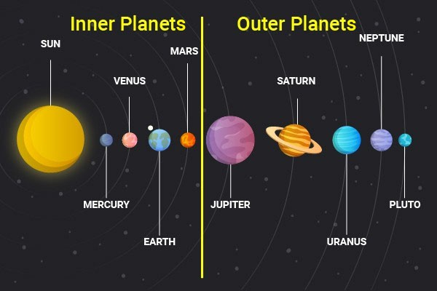
The planets are classified as:
Inner Planets and Outer Planets
Notes:
Print out of North Carolina unpacked standards for teacher plan book

Slide 17
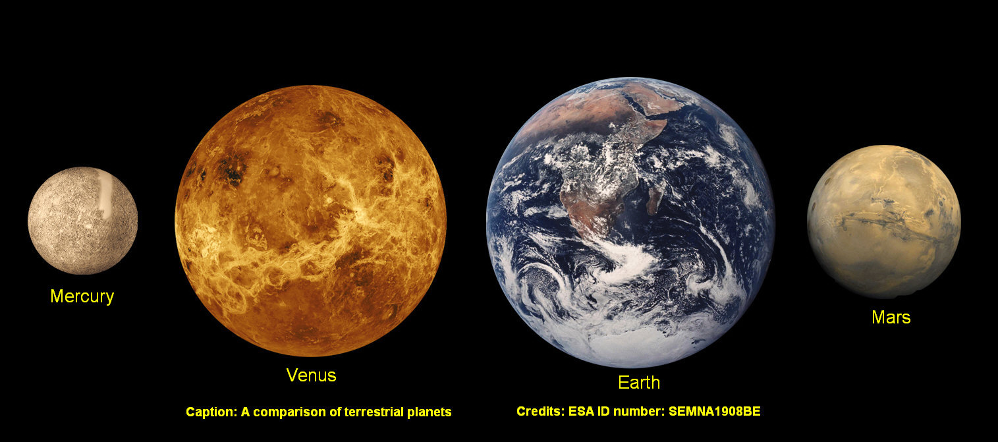
The inner planets include: Mercury, Venus, Earth and Mars.

Slide 18
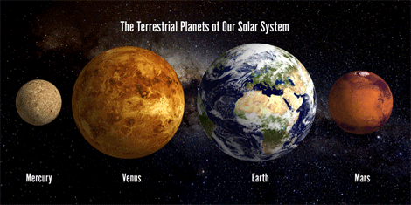
The inner planets are also called:
terrestrial planets because they are very dense and rocky.
Notes:
Print out of North Carolina unpacked standards for teacher plan book

Slide 19
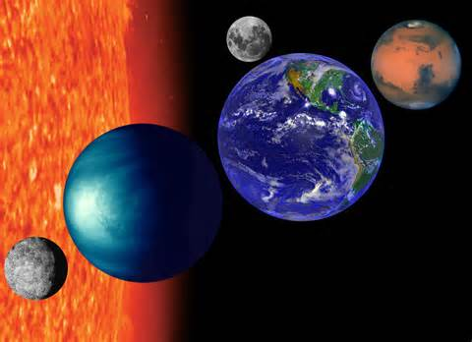
The inner planets are smaller, denser and rockier than the outer planets.

